Slide 1


K. RAMAKRISHNAN COLLEGE OF ENGINEERING
(AUTONOMOUS), SAMAYAPURAM – TRICHY
DEPARTMENT OF ARTIFICIAL INTELLIGENCE AND DATA SCIENCE
SMART DRESS TRACKER FOR ELDERLY PEOPLE
PRESENTED BY
GOKULA LAKSHMI.R – 8115U24AD033
HARINI.V.K – 8115U24AD035
KESHIYA.C – 8115U24AD048
MADUKSHA.K – 8115U24AD055

Slide 2
PRESENTATION OVERVIEW
Objective
Problem identification
Existing system
Disadvantage
Proposed System
Advantages
System Architecture
Modules
Conclusion

Slide 3
OBJECTIVE
To design a smart dress tracker that discreetly monitors and protects elderly individuals (especially those with dementia or mobility issues), by continuously tracking vital signs and activities to enhance safety and caregiver support.

Slide 4
PROBLEM IDENTIFICATION
Elderly individuals living alone or with mobility limitations are at heightened risk of unnoticed falls, prolonged inactivity, wandering, and other emergencies.
Caregivers often experience stress, vigilance fatigue, and gaps in timely response to incidents.
Smart tracker systems can be expensive, complex, or poorly integrated with user limitations.

Slide 5
EXISTING SYSTEM
Smart vest (STA home-nursing): Monitors movement patterns—e.g., getting up at night, bathroom duration, immobility, leaving the house—via remote tracking in home settings.
Intelligent smart clothing system: Uses ECG sensors, algorithms like Fast-EMD (for denoising) and Hidden Markov Models (for fall detection), offering eight services: life-sign surveillance, physiological tracking, activity area monitoring, anti-lost, fall detection, emergency call, wear detection, low-battery alert.

Slide 6
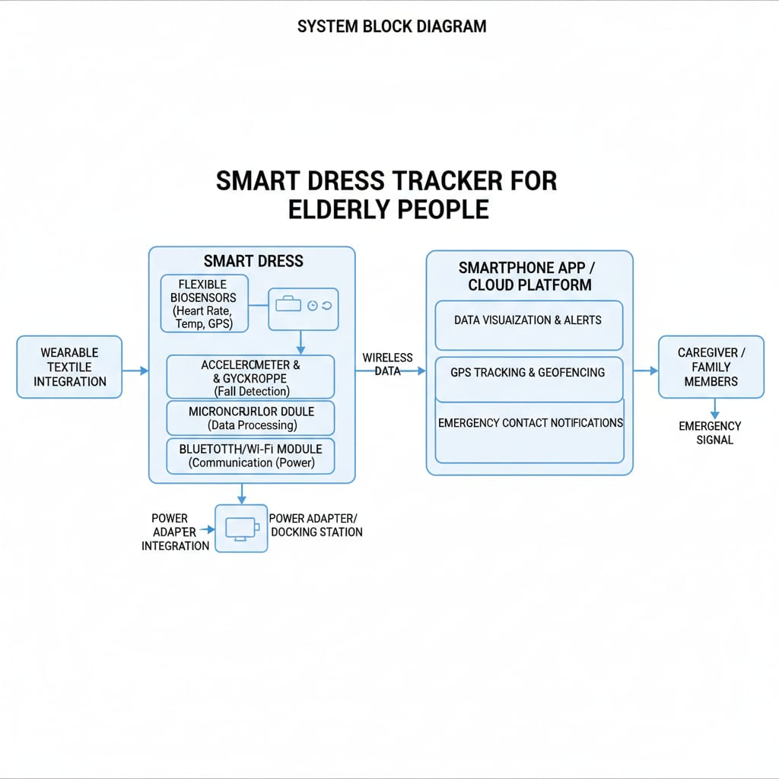
ARCHITECHTURE DIAGRAM

Slide 7
MODULES
Sensor Module: ECG, GPS sensors, etc.
Signal Processing Module: Implements Fast-EMD and HMM algorithms for data denoising and fall detection.
Communication Module: BLE/Wi-Fi for data transmission to caregiver interface or backend.

Slide 8
MODULE 1 - SENSOR
The components that detect and measure physical or biochemical signals.
It collects the heart rate - Helps in early detection of abnormal cardiac conditions.
Collects Temperature - Useful for detecting fever, hypothermia, or sudden temperature changes.
Fall Detection - Identifies sudden falls or impacts.
GPS - Tracking Real time location of the elderly people.

Slide 9
MODULE 2 - SIGNAL PROCESSING
A signal processing module is an integrated system designed to analyze, modify, and interpret signals.
Collects raw data from sensors such as heart rate, temperature, motion, and GPS.
Removes unwanted noise and interference from sensor signals.
Converts analog signals into digital form using ADC.
Ensures compatibility with the microcontroller and processing unit.

Slide 10
MODULE 3 - COMMUNICATION
Transfers processed sensor data from the smart dress to external devices.
Bluetooth is used for short-range communication with smartphones.
Sends health parameters and alerts to a mobile application.
Automatically sends alerts during critical situations such as falls or abnormal vitals.

Slide 11
CORE FEATURES
Status at a Glance: Checks the wearer's current location, device battery life, and activity level.
Alert History: Reviews past fall alerts, SOS button presses, and boundary breaches.
Health Data Trend Analysis: Allows the caregiver and doctors to review changes in vital signs, sleep quality, or activity over weeks and months.

Slide 12
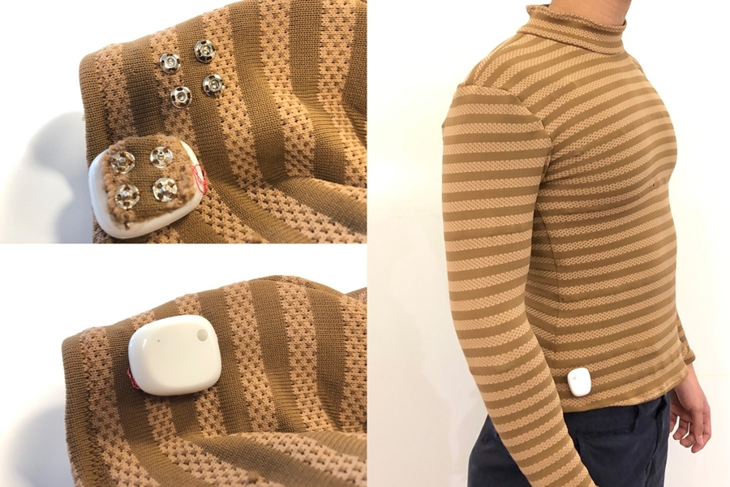
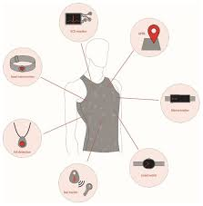
SAMPLE REAL WORLD IMPLEMATAION

Slide 13
CONCLUSION
This Smart Dress Tracker model leverages smart textile design and advanced signal processing to deliver accurate, non-intrusive elderly monitoring. By addressing existing obstacles like usability, transmission, environmental compatibility through robust architecture and caregiver-focused alerts, it promises improved safety, autonomy, and peace of mind for both users and their families.

Slide 14


